Slide 1
Supervised Learning: Evaluation Methodologies
Rayid Ghani
Slides liberally borrowed and customized from lots of excellent online sources

Slide 2
How to solve a prediction problem
Define and Create Rows (unit of prediction)
Define and Create Label (outcome variable)
Define and Create Features (predictors)
Create Training and Validation Sets
Train model(s) on Training Set
Validate model(s) on Validation Set
Select “best” model

Slide 3
Modeling Steps
Training
Features
Training
Learned model
Training Data
Labels/Outcomes
Testing/Validation
Apply Model
Test Data
Features
Predictions
Evaluate
Labels
Metrics

Slide 4
Validation
You’ve run a large number of different types of models
You need to understand what types of models work when, and
You need to decide which one(s) to use in the future

Slide 5
What we need to validate
Validation Methodology
Validation Metric(s) (need to match your policy goals)
Comparison with baselines (to know if you’re effective)

Slide 6
In-sample
Data
Train
Test

Slide 7
Out-of-Sample
Data
Train
Test

Slide 8
N-fold Cross-Validation
Data
1
2
3
4
5
Train
Test

Slide 9
N-fold Cross-Validation
Data
1
2
3
4
5
Train
Test

Slide 10
N-fold Cross-Validation
Data
1
2
3
4
5
Train
Test

Slide 11
N-fold Cross-Validation
Data
1
2
3
4
5
Train
Test

Slide 12
N-fold Cross-Validation
Data
1
2
3
4
5
Train
Test

Slide 13
Temporal Holdouts
Data
2002 2017
Train
Test
2002 2007 2008
Train
Test
2002 2008 2009
Train
Test
2002 2009 2010

Slide 15
Training - Time splits
Train
Test
2002 2009 2010
Train
We only use this time
to get outcomes
2002 2009

Slide 16
Evaluation - Methodology
In-sample
Out of sample
Multiple Out-of-sample (Hold-out) Splits
Cross Validation
Leave one out (LOO)
K fold
Temporal Holdouts

Slide 17
Score Distribution on the Test Set
# of people
Score

Slide 18
Evaluation - Metrics
Predictions are often scores between 0 and 1
We need to first turn them into 0 or 1 by selecting a threshold
Predicted Class
 | Yes | No
Yes | True Positives (TP) | False Negatives (FN)
No | False Positives (FP) | True Negatives (TN)
Actual Class

Slide 19
Evaluation – Metrics (at a threshold k)
Accuracy = (TP + TN) / (TP + TN + FP + FN)
Precision (or PPV) = TP / (TP + FP)
Recall (or Sensitivity) = TP / (TP + FN)
Specificity = TNR
Predicted
 | Yes | No
Yes | True Positives (TP) | False Negatives (FN)
No | False Positives (FP) | True Negatives (TN)
Actual

Slide 20
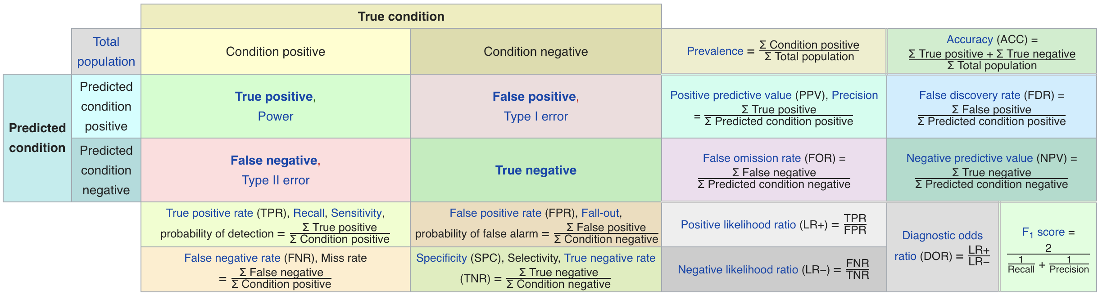
Metric Cheatsheet
Source: https://en.wikipedia.org/wiki/Sensitivity_and_specificity

Slide 21
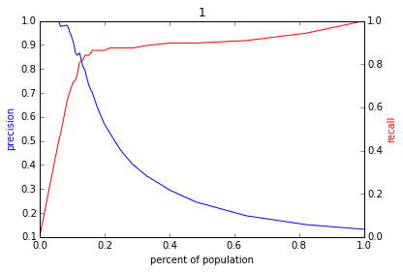
Varying the Threshold
Score
1 .9 .8 .7 .6 .5 .4 .3. .2 .1
| | | | | | | | | |
Baseline

Slide 22
ROC Curve
Receiver Operator Characteristic Curve

Slide 23
AUC (Area Under Curve)
Overall measure of performance
1 if all 1s are ranked above all 0s
0 if all 0s are above all 1s

Slide 24
Evaluation - Baselines
Random (predict most frequent class)
Simple heuristics
Expert heuristics (what may be in use today)

Slide 26
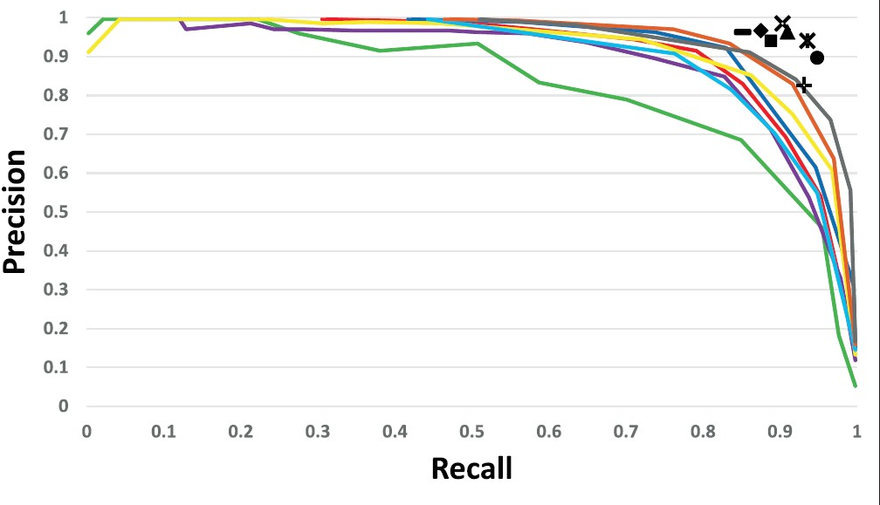
Precision Recall Curves

Slide 27
ROC Curve
Receiver Operator Characteristic Curve

Slide 28
AUC – Area Under Curve
If you care about the entire space

Slide 29
Evaluation - Baselines
Random (predict most frequent class)
Simple heuristics
Expert heuristics
Simple 1 or 2 deep Decision tree is a good heuristic baseline

Slide 30
Leakage
Data used to train the model contains information about what we’re trying to predict
Will result in better-than-expected, overconfident results
Examples
Including the ground truth (or proxy) as a predictor
Imputing/normalizing the entire dataset
Using future data to make predictions on the past
Using any information not available at time of prediction

Slide 31
Resources
Sklearn evaluation functions

Slide 32
The wonderful for loop
For train-test splits (CV or temporal)
For subsets of Feature Sets (Demographic only, Behavior only, Temporal only, etc.)
For Classifiers (RFC, SVM, DT, NN, Logit, GB, Boosting)
For parameters (cross products of different parameters)
Fit
Predict
Evaluate

Slide 33
Results
Classifier | Param 1 | Param 2 | Test Split | Feature Subsets used | Accuracy | Prec @ 1% | AUC

Slide 34
Analyzing the results
Which approaches work best?
Which classifiers?
Which parameters?
Over which metrics?
Value of different features/feature sets?
Variance in performance over time?
Highest average?
Lowest variance?
Getting better over time?

Slide 35
Evaluation
Offline
Train
Test
Live Testing / Experiment
A/B
Multi-Armed Bandit

Slide 36
Sample (Validation) Experiment
Select best model using train-test splits
Train on all the labeled data
Experiment
Randomize splits
Split 1: Random
Split 2: Model Prediction
Split 3: Existing Approach

Slide 37
Examples

Slide 38
What to test in an experiment?
Probability estimates?
Ranking?
How does the experiment design change?

